Slide 1

Toshiba/NSTA ExploraVision
Introducing STEM Competition in Your Classroom
-- Program Guide --

Slide 2
How to use this presentation and slide deck
Feel free to use this presentation to introduce the Toshiba/NSTA ExploraVision competition and program at a high level to your school leadership, parents and students.
The following slide deck is meant to serve as a framework for your teams to get started and provide thoughts as to how the coach will approach the competition this year!
If you have any questions, feel free to contact us at exploravision@nsta.org.

Slide 3
About Toshiba/NSTA ExploraVision
ExploraVision is a STEM competition for K-12 students.
It encourages students to combine their imagination with their knowledge of science and technology to explore visions for the future.
Teams of 2-4 students select a technology, research how it works, learn why it was invented, and then predict how that technology may change in the future.
Students identify what “breakthroughs” are required for their idea to become a reality and describe the positive and negative consequences of their technology on society.
The students write a paper and develop a one-page Technolgy Launch Flyer to describe and communicate their idea.
Finalists make an enhanced 2-page flyer and a prototype of their future vision.
ExploraVision is more than a science fair or a competition—it can be a virtual or in-person tool to ignite every student’s love of STEM subjects!

Slide 4
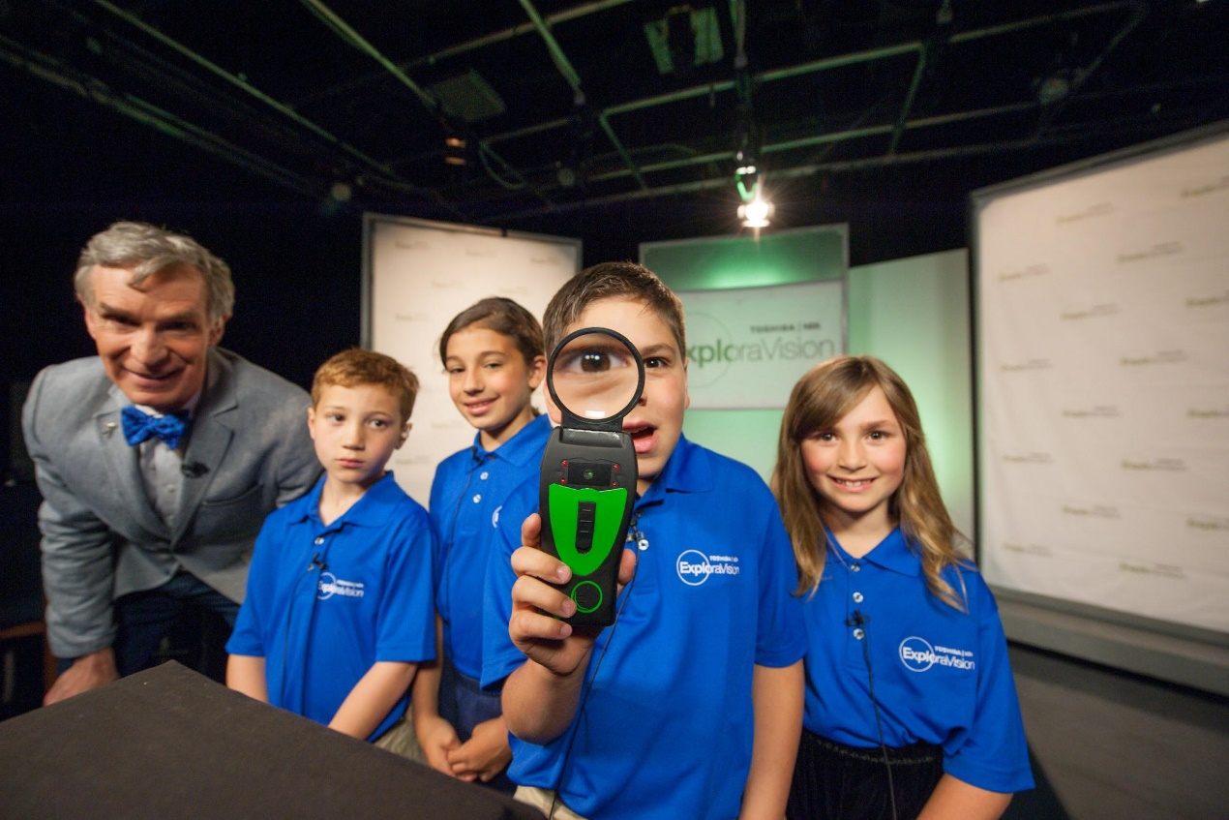
Video About Toshiba/NSTA ExploraVision
Watch Bill Nye Explains How ExploraVision Inspires STEM Learning
Watch what the ExploraVision winning teachers, students, and alumuni say about the program on this YouTube Channel

Slide 5
Why Participate in ExploraVision?
Engage students in project-based learning to solve real world problems
Help students, teachers, and the community become interested in STEM
Help students develop skills such as critical thinking and communication
Teach students how to work effectively in groups on an interdisciplinary project
Help steer students toward a lifetime of learning and curiosity
Teach multiple subjects in one project: STEAM, English, research & history
FREE to enter and everyone who enters receives a gift and a certificate from ExploraVision!

Slide 6
Prizes -- For The Students
$10,000* savings bond OR $5,000 cash OR $5,000 529 plan contribution for each first-place team member and $5,000* savings bond OR $2,500 cash OR $2,500 529 plan contribution for each second-place team member
An all-expenses paid trip to Washington, D.C. in June for ExploraVision Awards Weekend for each national winning student and their parents/guardians for students in grades K-6
A gift for each regional winning student
Recognition for Honorable Mention students in the top 10% of winning teams
A certificate of participation and an entry gift for every student who submits a complete project
* Savings bonds maturity value

Slide 7
Prizes -- For The Schools
A technology/science-related gift for each of the schools of the regional winning teams
National press coverage and national recognition
An awards ceremony for each regional winning team at their school where they will receive a winner’s banner

Slide 8
Prizes -- For Coaches and Mentors
An all-expenses-paid trip to Washington, D.C. in June for ExploraVision Awards Weekend for the coach or mentor of each national winning team
A one-year NSTA membership for coaches of the national winning teams
A plaque for the coach and mentor of each national winning team
A gift for the coach of each regional winning team
A certificate of participation and an entry gift for each coach and mentor of every team that submits a complete project

Slide 9
ExploraVision Key Dates
Coach registration Open: August 25, 2026 at www.exploravision.org
Project Entry Due: 8PM EST, January 27, 2027 at www.exploravision.org
Regional Winner Announcement: March 10, 2027
National Winner Announcement: April 28, 2027
Awards Weekend: June 9-12, 2027 in Washington, D.C. area

Slide 10
General Requirements -- Students
Must be full-time K-12 students
Must be currently enrolled in and attending a public, private, parochial, virtual school or home school in the U.S. or Canada (includes U.S. territories and DoWEA schools)
Must be younger than 21
May only be on one team and only submit one project

Slide 11
General Requirements -- Coaches/Mentors
Coaches:
Are required for each team
Must be known to at least one of the team members
Can be a teacher, a parent/guardian of a team member, a counselor, or a leader of a yourth organization; must be at least 21 years old
May enter an unlimited number of teams
Should guide the students but not perform work on the project
Mentors:
Are optional
Can be an individual that represents an organization or business or be a parent/guardian of a team member
Should serve as a resource for the team but not perform work on the project

Slide 12
Project Entry Process
Step 1: Coach registration at www.exploravision.org
Step 2: Register your team
Step 3: Teams begin working on their projects (e.g. brainstorm topics, research, etc.)
Step 4: Upload and enter projects
Notes:
  Team projects are entered online by the coach
  A coach may register as many teams as he/she wishes
  A coach is given a unique link upon registration to submit team information and projects
  Project must be submitted online by 8:00 PM EST on January 27, 2027 to be considered

Slide 13
Project Format
Grades K-3 Requirements
K-3 grades team have a choice to submit projects in two types of format.
• A storyboard format, to download, click Grades-K-3-Storyboard-Template. Standard • ExploraVision Project Format, click here.
Grades 4-6 Requirements
4-6 grades teams have a choice to submit projects in two types of format.
  To download, click Grades-4-6-Presentation-Format-Template.
  Standard ExploraVision Project Format, click here.
Grades 7-9 and 10-12 Requirements
Standard ExploraVision Project Format, click here.

Slide 14
Required Standard ExploraVision Project Format Components
Abstract -- 4 points
Description -- 81 points
  Present Technology -- 10 points
  History -- 10 points
  Future Technology -- 24 points
  Breakthroughs -- 17 points
  Design Process -- 10 points
  Consequences -- 10 points
Bibliography -- 5 points
Technology Launch Flyer -- 10 points
TOTAL POINTS -- 100 points
* Above sections should be clearly labeled and presented in exact order
No student, coach, mentor, or school names should appear in text or as titles on submitted files.

Slide 15
Abstract
Abstract of no more than 150 words that summarizes the proposed future technology and other relevant information must precede other project components
Abstract should be submitted separately accept for K-3 and 4-6.
No name of school/student/teacher/mentor should be stated on documetns or as titles of files.
It should be typed*, double-spaced and clearly labeled
No minimum word count
  * K-3 may hand print their abstract on the template.
  4-6 may use presentation format and should follow those guidelines

Slide 16
II. Description
Each team must prepare a written description of the project that does not exceed 11 pages and can be a combination of text and artwork in a standard format (manuscript).
Must include the following sections-with headings clearly labeled- in the following order:
  Present Technology*
  History
  Future Technology
  Breakthroughs*
  Design Process*
  Consequences*
* Section is central to Next Generation Science Standards

Slide 17
II. Description -- 1/4
Present Technology
Give overview of chosen technology’s current form, including scientific principles involved in its functioning.
Define a problem or limitation of this current technology that you will address in your ExploraVision project.
B. History
Research and describe the history of the technology from its inception.

Slide 18
II. Description -- 2/4
C. Future Technology
Describe the team’s vision for what this technology will be in the future, including scientific principles involved in developing the technology.
D. Breakthroughs
Research and describe breakthroughs that are necessary to make the future technology design a reality.
Describe why this future technology doesn’t exist today.
Choose one of your required breakthroughs and describe an investigation that would have to be planned and carried out to test your ExploraVision project. If possible, include the kind of data or measurements that would be collected in the investigation.

Slide 19
II. Description -- 3/4
E. Design Process
Describe three alternative ideas of features the team considered for their future technology. The ideas and features should be directly related to the future technology, not a list related to other projects.
Describe why the team rejected each feature and idea in favor of the ones in the submitted technology.
Describe how your future technology feature is better than the rejected design feature.

Slide 20
II. Description -- 4/4
F. Consequences
Recognizing that all technologies have positive and negative consequences, describe the potential positive and negative consequences of the new technology on society

Slide 21
III. Bibliography
All sources used in researching the chosen technology should be referenced in the Bibliography.
Sources must be clearly labeled and include title, author, publisher, and copyright date.
Not counted as part of the 11-page limit for the Description.
Footnotes are encouraged, but not required.
No page limit for the Bibliography section.
AI and the tool ChatGPT may be used to brainstorm and/or research your project ideas. These should be used as a tool, but not as the only resource for your project. AI may not be used to generate a drawing of your prototype. Any information generated by these resources must be included in the bibliography with the proper citations from the original resources. ExploraVision submissions must adhere to the AI policy. Access the AI Acceptable Use Chart for examples.

Slide 22
IV. Technology Launch Flyer
Teams must create a one-page Technology Launch Flyer that introduces their future technology to the public for the first time.
They should imagine it is 10 or more years in the future, their technology has been developed, and it is ready to make an impact.
The flyer should promote the technology clearly and creatively, explaining why the public should be interested and communicating its value and importance.
The flyer must include a visual representation of the prototype; the image may not be generated or drawn using AI.
Teams do not need to build a prototype until a team becomes a Regional Winner.

Slide 23
Submission
Please avoid disqualification by using the check-off list prior to submission.
Many creative and excellent projects are disqualified each year due to teams not following the rules and the project regulations.
Please ensure that teams “check off” each item on the list (downloadable as a PDF below) before submitting.
  K-3 storyboard and 4-6 presentation format Check Off List
  Standard Manuscript Format Check Off List

Slide 24
Regional Judging
The judging committees are made up of leading science educators and science and technology experts
Judging is divided into two phases: regional and national judging
All eligible projects will be evaluated in the regional judging phase
24 regional winning teams will move on to national judging
The judging criteria for assigning points are based on creativity, scientific accuracy, communication, and feasibility of the project’s vision
Judges award higher scores to entries that are unique and different from those that have won previously
Before submitting, use the rubric (download here) to help get the maximum points

Slide 25
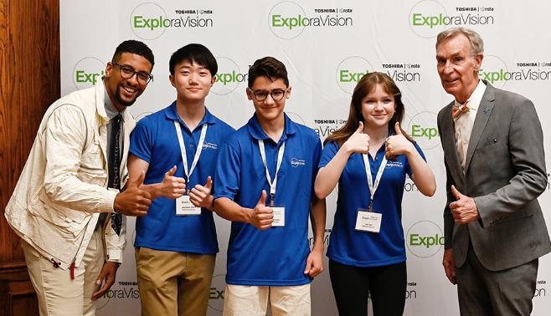

Resources
Sample Project Development Timeline
Register you and your students team
Sample Projects
Lesson Guide
For more information
FAQ
Facebook
X
Instagram
Email: exploravision@nsta.org
Through Toshiba’s shared mission partnership with NSTA, the Toshiba/NSTA ExploraVision competition makes a vital contribution to the educational community

