Slide 1

Toshiba/NSTA ExploraVision
Introducing STEM Competition in Your Classroom
-- Program Guide --

Slide 2
How to use this presentation and slide deck
Feel free to use this presentation to introduce the Toshiba/NSTA ExploraVision competition and program at a high level to your school leadership, parents and students.
The following slide deck is meant to serve as a framework for your teams to get started and provide thoughts as to how the coach will approach the competition this year!
If you have any questions, feel free to contact us at exploravision@nsta.org.

Slide 3
About Toshiba/NSTA ExploraVision
ExploraVision is a STEM competition for K-12 students.
It encourages students to combine their imagination with their knowledge of science and technology to explore visions for the future.
Teams of 2-4 students select a technology, research how it works, learn why it was invented, and then predict how that technology may change in the future.
Students identify what “breakthroughs” are required for their idea to become a reality and describe the positive and negative consequences of their technology on society.
The students write a paper and draw a series of web pages to describe and communicate their idea.
Finalists make a visual poster (for K-3 grades) and an actual website (for 4-12 grades) and a prototype of their future vision.
ExploraVision is more than a science fair or a competition—it can be a virtual or in-person tool to ignite every student’s love of STEM subjects!

Slide 4
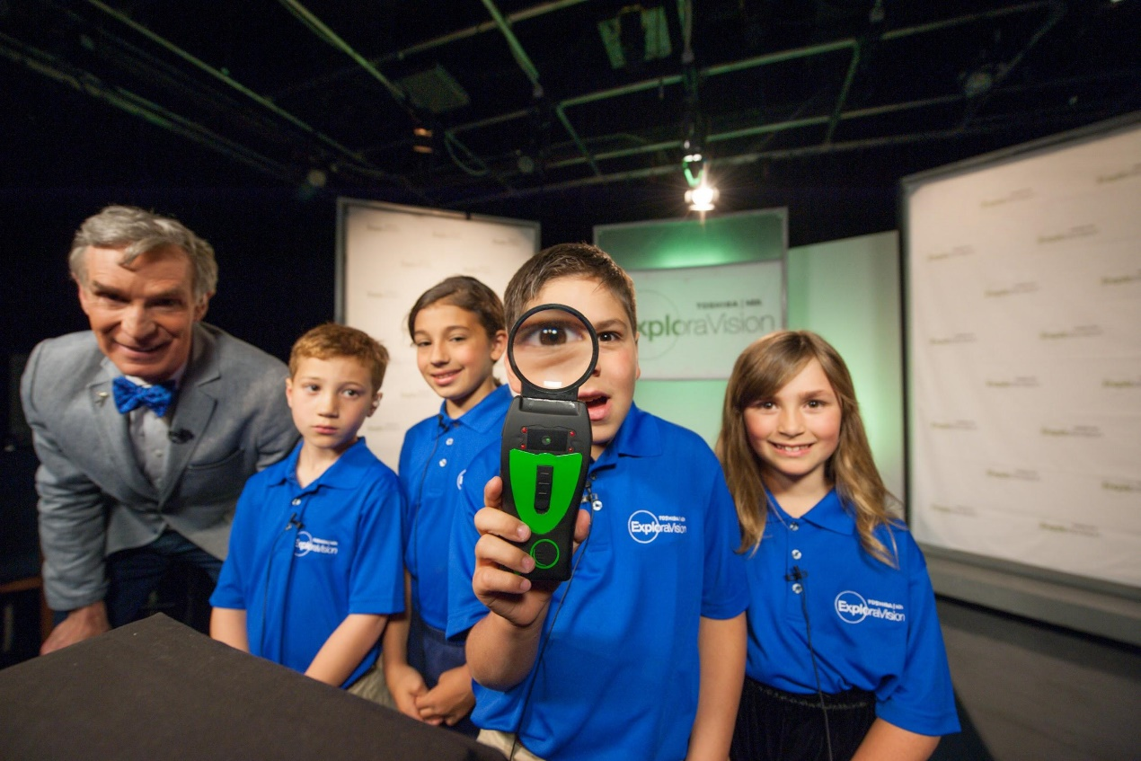
Video About Toshiba/NSTA ExploraVision
Watch About ExploraVision video
What Bill Nye the Science Guy has to say about the program (click here)
Watch what the ExploraVision winning teachers, students, and alumuni say about the program on this YouTube Channel

Slide 5
Why Participate in ExploraVision?
Engage students in project-based learning to solve real world problems
Help students, teachers, and the community become interested in STEM
Help students develop skills such as critical thinking and communication
Teach students how to work effectively in groups on an interdisciplinary project
Help steer students toward a lifetime of learning and curiosity
Teach multiple subjects in one project: STEAM, English, research & history
FREE to enter and everyone who enters receives a gift and a certificate from ExploraVision!

Slide 6
Prizes -- For The Students
$10,000* savings bond for each first-place team member and $5,000* for each second-place team member
An all-expenses paid trip to Washington, D.C. in June for ExploraVision Awards Weekend for each national winning student and their parents/guardians for students in grades K-6
A Chromebook for each regional winning student
A unique prize for all students on the 500 Honorable Mention winning teams
A certificate of participation and an entry gift for every student who submits a complete project
* Savings bonds maturity value

Slide 7
Prizes -- For The Schools
A technology/science-related gift for each of the schools of the regional winning teams
National press coverage and national recognition
An awards ceremony for each regional winning team at their school where they will receive a winner’s banner, plaque, and other gifts

Slide 8
Prizes -- For Coaches and Mentors
An all-expenses-paid trip to Washington, D.C. in June for ExploraVision Awards Weekend for the coach or mentor of each national winning team
A one-year NSTA membership for coaches of the national winning teams
A plaque for the coach and mentor of each national winning team
A Chromebook for the coach of each regional winning team
A certificate of participation and an entry gift for each coach and mentor of every team that submits a complete project

Slide 9
ExploraVision Key Dates
Coach registration Open: August 19, 2025 at www.exploravision.org
Project Entry Due: 7:00 PM EST, February 3, 2026 at www.exploravision.org
Regional Winner Announcement: March 9, 2026
National Winner Announcement: April 27, 2026
Awards Weekend: June 3-6, 2026 in Washington, D.C.

Slide 10
General Requirements -- Students
Must be full-time K-12 students
Must be currently enrolled in and attending a public, private, parochial, virtual school or home school in the U.S. or Canada (includes U.S. territories and DoDEA schools)
Must be younger than 21
May only be on one team and only submit one project

Slide 11
General Requirements -- Coaches/Mentors
Coaches:
Are required for each team
Must be known to at least one of the team members
Can be a teacher, a parent/guardian of a team member, a counselor, or a leader of a yourth organization; must be at least 21 years old
May enter an unlimited number of teams
Should guide the students but not perform work on the project
Mentors:
Are optional
Can be an individual that represents an organization or business or be a parent/guardian of a team member
Should serve as a resource for the team but not perform work on the project

Slide 12
Project Entry Process
Step 1: Coach registration at www.exploravision.org
Step 2: Register your team
Step 3: Teams begin working on their projects (e.g. brainstorm topics, research, etc.)
Step 4: Upload and enter projects
Notes:
  Team projects are entered online by the coach
  A coach may register as many teams as he/she wishes
  A coach is given a unique link upon registration to submit team information and projects
  Project must be submitted online by 7:00 PM EST on February 3, 2026 to be considered

Slide 13
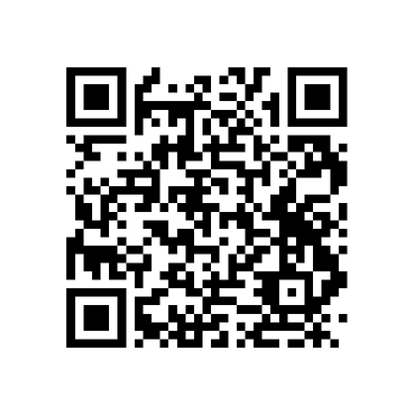
Project Format -Scan the QR code below to access videos highlighting the information.
Grades K-3 Requirements
K-3 grades team have a choice to submit projects in two types of format.
• A storyboard format, to download, click Grades-K-3-Storyboard-Template. Standard • ExploraVision Project Format, click here.
Grades 4-6 Requirements
4-6 grades teams have a choice to submit projects in two types of format.
  To download, click Grades-4-6-Presentation-Format-Template.
  Standard ExploraVision Project Format, click here.
Grades 7-9 and 10-12 Requirements
Scan the QR code to standard entry format, access videos on requirements,
avoiding disqualification and more!

Slide 14
Required Standard ExploraVision Project Format Components
Abstract -- 10 points
Description -- 10 points
  Present Technology -- 10 points
  History -- 10 points
  Future Technology -- 20 points
  Breakthroughs -- 15 points
  Design Process -- 10 points
  Consequences -- 10 points
Bibliography -- 5 points
Sample Web Pages -- 20 points
* Above sections should be clearly labeled and presented in exact order
No student, coach, mentor, or school names should appear in text or as titles on submitted files.

Slide 15
Abstract
Abstract of no more than 150 words that summarizes the proposed future technology and other relevant information must precede other project components
Abstract should be on a separate page and does not count as part of the Description.
No name of school/student/teacher/mentor should be stated on documetns or as titles of files.
It should be typed*, double-spaced and clearly labeled
No minimum word count
  * K-3 may hand print their abstract on the template.

Slide 16
II. Description
Each team must prepare a written description of the project that does not exceed 11 pages and can be a combination of text and artwork.
Must include the following sections-with headings clearly labeled- in the following order:
  Present Technology*
  History
  Future Technology
  Breakthroughs*
  Design Process*
  Consequences*
* Section is central to Next Generation Science Standards

Slide 17
II. Description -- 1/4
Present Technology
Give overview of chosen technology’s current form, including scientific principles involved in its functioning.
Define a problem or limitation of this current technology that you will address in your ExploraVision project.
B. History
Research and describe the history of the technology from its inception.

Slide 18
II. Description -- 2/4
C. Future Technology
Describe the team’s vision for what this technology will be in the future, including scientific principles involved in developing the technology.
D. Breakthroughs
Research and describe breakthroughs that are necessary to make the future technology design a reality.
Describe why this future technology doesn’t exist today.
Choose one of your required breakthroughs and describe an investigation that would have to be planned and carried out to test your ExploraVision project. If possible, include the kind of data or measurements that would be collected in the investigation.

Slide 19
II. Description -- 3/4
E. Design Process
Describe three alternative ideas of features the team considered for their project. The ideas and features should be directly related to the project, not a list related to other projects submitted in previous years or by other participants.
Describe why the team rejected each feature and idea in favor of the ones in the submitted technology.
Describe how your future technology feature is better than the rejected design feature.

Slide 20
II. Description -- 4/4
F. Consequences
Recognizing that all technologies have positive and negative consequences, describe the potential positive and negative consequences of the new technology on society

Slide 21
III. Bibliography
All sources used in researching the chosen technology should be referenced in the Bibliography.
Sources must be clearly labeled and include title, author, publisher, and copyright date.
Not counted as part of the 11-page limit for the Description.
Footnotes are encouraged, but not required.
No page limit for the Bibliography section.
Use of AI tools, including ChatGPT, is permitted and may be used to brainstorm and/or research your project ideas. Any information generated by these resources must be included in the bibliography with the proper citations from the original resources. Citations should include not only in-text citations and listing in the bibliography, but also the link to the full text of cited ChatGPT (or other Large Language Model (LLM) generator).

Slide 22
IV. Sample Web Pages
Team members must prepare exactly five sample web pages that communicate and promote their future technology vision.
Must include description and illustration of the chosen technology.
One of the five pages should be a model or visual representation of the technology that could be used to create a prototype for display.
The model should help others visualize the design and should communicate the design features.
Web pages can be hand-drawn, on an actual website, or computer generated with text, pictures, photographs and diagrams.

Slide 23
Submission
Please avoid disqualification by using the check-off list prior to submission.
Many creative and excellent projects are disqualified each year due to teams not following the rules and the project regulations.
Please ensure that teams “check off” each item on the list (downloadable as a PDF here) before submitting.

Slide 24
Regional Judging
The judging committees are made up of leading science educators and science and technology experts
Judging is divided into two phases: regional and national judging
All eligible projects will be evaluated in the regional judging phase
24 regional winning teams will move on to national judging
The judging criteria for assigning points are based on creativity, scientific accuracy, communication, and feasibility of the project’s vision
Judges award higher scores to entries that are unique and different from those that have won previously

Slide 25
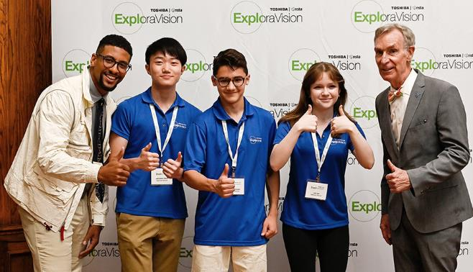

Resources
Sample Project Development Timeline
Register you and your students team
Sample Projects
Lesson Guide
For more information
FAQ
Facebook
X formerly know as Twitter
Email: exploravision@nsta.org
Through Toshiba’s shared mission partnership with NSTA, the Toshiba/NSTA ExploraVision competition makes a vital contribution to the educational community

