Slide 1
An Introduction to Problem Solving Through Project-Based Learning
An all-in-one STEM guide for getting starting with ExploraVision
For educators teaching grades K-6 in the U.S. and Canada

Slide 2
Table of Contents
What and why ExploraVision and how can you incorporate in your classroom?
Introducing the Toshiba/NSTA ExploraVision competition
Brainstorming: Solve Problems by Asking Questions
Brainstorming: Inventors Who Solved Problems
Brainstorming: Generating ExploraVision Ideas
Research: Understanding Your Topic
Research: Past ExploraVision Winners
Research: Engineering Process for Problem Solving
Research: Components Required to Complete a Project
Key Components: Consequences, Design Process, and Breakthroughs
Summary and Sources: Abstract and Bibliography
Communication: Website & Video
Judge Expectations
Project Resources

Slide 3
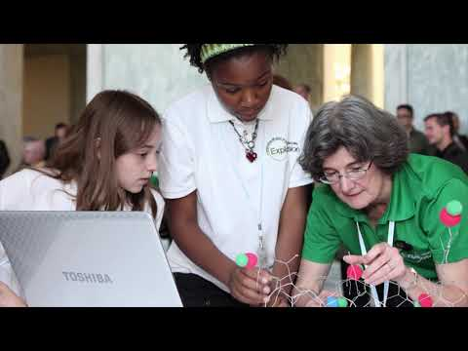
What is ExploraVision?
Through Toshiba’s shared mission and partnership with NSTA, the Toshiba/NSTA ExploraVision competition has made a vital contribution to the educational community for 29 years. It is a FREE virtual or in-person collabrative program and all students receive recognition for participating in the competition.
Click the image to watch the “about ExploraVision” video

Slide 4
Why ExploraVision?
Why Bill Nye the Science Guy loves ExploraVision and his advice for students
Click the image to watch why Bill Nye support ExploraVision

Slide 5
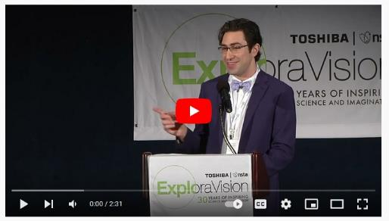
Why ExploraVision?
How much fun the ExploraVision past winner had with working on ExploraVision, what he has learned from the program, and his advice for students
Click the image to watch how ExploraVision made a difference

Slide 6
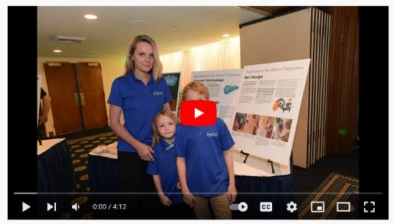
How can you engage young kids?
How did a K-3 mentor engage younger kids in ExploraVision? Learn from her about how to encourage young minds and to on course
Click the image to watch how to implement ExploraVision to K-3 kids

Slide 7
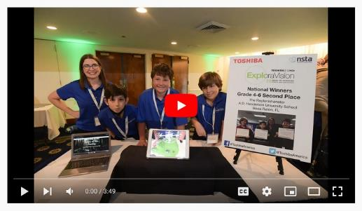
How can you incorporate in your classroom?
How do you engage younger students in ExploraVision? Learn from Ms. Jennifer O Sullivan, a 4-6 teacher, who uses the program and her advise,
Click the image to watch how to implement ExploraVision in your classroom

Slide 8
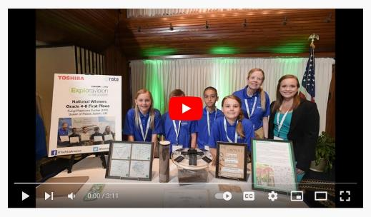
How can you incorporate in your classroom?
How do you engage younger students in ExploraVision? Learn from Ms. Maureen Foelkl, a 4-6 teacher, who uses the program and her advise,

Slide 9
Introducing Toshiba/NSTA ExploraVision
ExploraVision is a STEM competition for K-12 students in the US and Canada
It challenges students to think creatively yet collabratively about current scientific research and technology and its limitations
Teams of 2-4 research an existing technology and envision what that technology might look like 10 and more years in the future
Teams then identify what scientific “breakthroughs” are required for their idea to become a reality and describe the consequences that technology may have on society
Teams then describe the idea with a visual in online form
Then 4-12 grade finalists develop a prototype, build a website with a short video, or live online presentation to judges of their invention
K-3 finalists create vitual poster and live online presentation to judges
ExploraVision is more than a science fair or a competition—it lets you dream big and solve a problem you care about using science!
Notes:
Teacher notes
Introduce the competition
Toshiba/NSTA ExploraVision engages students to showcase their innovative and creative problem-solving projects.
It also reinforces key skills that they already use everyday - creativity, communication, problem solving, critical thinking - and they can get rewarded for it with prizes (top prize: $10,000 savings bond, Chromebook, a trip to Washington, D.C., and a chance to meet Bill Nye the Science Guy!)
Open to all K-12 grades students in the U.S. and Canada, the competition has been running since 1992 and close to 450,000 students have participated. Students can explore some of the previous finalists on www.exploravision.org
It’s about finding a problem to solve, thinking about how you might solve it, and presenting your future solution.
Teachers play a coaching role and students form a group of up to four people- you could choose to group students at the start, or once they have thought of ideas.
Elaborate on “breakthroughs” and the “research paper.” You could use examples from the ExploraVision entry component page in this presentation

Slide 10
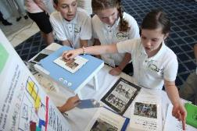
Brainstorming: Solve Problems by Asking Questions
How can we safely and easily bring light to people who need it?
How can we keep our clothing dry and stain-free?
How can we keep our soldiers safe from bullets?
How can we allow people to connect and find information easily?
Notes:
Teacher notes:
Elaborate on what “Brainstorming” is through this exercise
Ask students to answer these questions, and to think about famous inventors who have solved problems

Slide 11
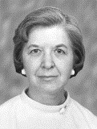
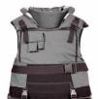
Brainstorming: Inventors Who Solved Problems
Early 1900’s: Ichisuke Fujioka developed an economical, durable, mass-market light bulb.
1956: Patsy Sherman invented Scotchgard, a water and stain repellent.
1965: Stephanie Kwolek invented Kevlar, a strong, synthetic fiber used in body armor.
2007: Steve Jobs developed Apple’s first widely-adopted smartphone.
Ichisuke Fujioka, a co-founderof Toshiba
Matsuda Lamp
Patsy Sherman, Chemist & Inventor, 3M
Scotchgard
Stephanie Kwolek, Chemist, DuPont
Kevlar
Steve Jobs, former CEO, Apple
iPhone Gen. 1
Notes:
Teacher notes
Explain how all these inventions solve a specific problem
Ask students to look around them and think ‘how could that be improved?’
Discuss the idea that inventions are often discussed in terms of impact - how much they have changed many people’s lives.
The first step in any invention is coming up with a problem that hasn’t been solved
It’s key that students are passionate about the problem

Slide 12
Brainstorming: Generating ExploraVision Ideas
Need help brainstorming? Encourage students to solve global challenges in the 17 areas addressed by the UN SDGs.
Past ExploraVision winners developed solutions to reduce food waste, eradicate disease, improve energy efficiency and more.
Learn more about UN SDGs

Slide 13
Brainstorming: Generating ExploraVision Ideas
Step One: Thought Starters
Does your family or community face any environmental or health issues?
Do any current technological devices or scientific solutions address these issues?
Are there any current events or problems that make you worried for your future? (Examples: pollution, climate change, disease, natural disasters)
What technology do people currently use and how could it be improved?
Think about which of these areas you are interested in learning more.
Notes:
Teacher notes
Ask your students to think about these questions and share their thoughts with the class
Collaborate with humanities teachers to introduce these brainstorming sessions into their lesson plans when discussing current events or social issues
Ask students to bring in current stories from news outlets or science websites to share with the class about these issues
Challenge students to pick a technology they use and think creatively about how it could be improved

Slide 14
Brainstorming: Generating ExploraVision Ideas
Step Two: Generating Investigative Questions About Problem Area
What questions do you have about the problem area?
Refine your questions:
How can we…? Is there an alternative to…? How much does…? Could we create…? What if…? Is it possible…?
Rank your questions in order of interest:
1.
2.
3.
Notes:
Teacher notes
Ask students to list all questions outlining what they would investigate.
Help your students to paraphrase their questions to “How can we...?” or “Is there an alternative to…?”
Students then rank their questions into the top three they’d like to investigate

Slide 15
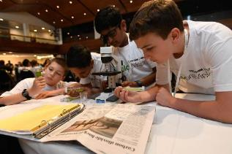
Brainstorming: Generating ExploraVision Ideas
Step Three: Categorizing Your Questions into Subject Areas
Do your investigative questions fall into any of these categories?
Climate change
Sustainable energy
Food shortage/population growth
Space
Healthcare/Pandemic
Mental health & social sciences
Robotics
Artificial Intelligence
Infrastructure/civil engineering (building bridges, etc.)
Can you expand or modify your questions based on these areas of concern?
Notes:
Teacher notes
Also introduce these areas of issues to students to help them expand their questions and area of concerns
Ask students to pick top three and share why they’re interested in the area of concerns
You may need to elaborate more on Artificial Intelligence

Slide 16
Research: Understanding Your Topic
How is your area of concern impacting local or global communities?
What improvements could be made in this area?
What inventions already exist in this area?
What recent improvements have there been in this area?
What key problems are there in this area?
What’s the history and future of the area?
Notes:
Teacher notes
Give homework depending on students’ area of concerns, provide further reading resources link to them;
For Kids: NASA Climate Change, Kids National Geographic, Robotics for kids, Referral MD, What’s Engineers, EIA for Kids, DOE Sustainable Energy, USTPO for Kids
For Teachers: Robotics, Science Friday, NASA, ASCE

Slide 17
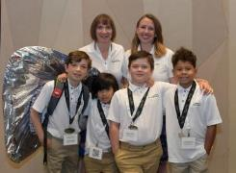
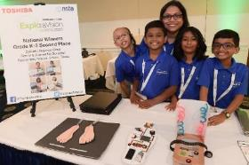
Past ExploraVision Winners, Grades K-3
A novel way to treat diabetic foot ulcer
Protection against armed violence
“My family suffers from diabetes, so I start reading about it. Then I found that every 30 seconds a leg is amputated and 85% of these amputations is due to diabetic foot ulcers.. -- Surabi Janakiraman
“We wanted to solve the problem of youth deaths from gun violence, because firearms are the number one cause of death for children in the US. – the MasterPack team
A lightweight bulletproof backpack, MASTERPACK, is made from graphene material which will include an expandable graphene shield, GPS locator, radio wave communication, and will be powered by radio frequency energy harvesting. It will also include a net launcher that can trap and hopefully stop or trip a shooter. It’s a backpack with zippers, storage compartments for your lunch and schoolwork and in cool colors and designs that kids will want to wear.
The Diabetic-Balance, “DiaBal” shoe helps detect and prevent diabetic foot ulcers by using different sensors for pain, blood flow/pressure/sugar and temperature. Sensors detect loss of balance and use motors and conveyor belts to spread the feet, stabilize and prevent falling.
Notes:
Teacher notes
Explain that all these inventions solve a specific problem
Ask students to look around them and think ‘how could that be better?
Discuss the idea that inventions are often discussed in terms of impact - how much they have changed many people’s lives.
The first step in coming up with a problem and haven’t been solved
It’s key that students are passionate about the problem

Slide 18
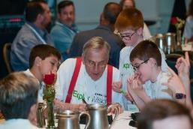
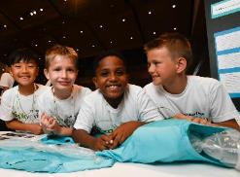
Past ExploraVision Winners, Grades K-3
A team of unmanned drones to extinguish wildfire safely
Help Kids Enjoy Swimming and prevent them from Drowning
“Wildfires in the US are a big problem, destroying a lot of land, which is a habitat for plants and animals. If trees keep being destroyed there will be less clear air for humans and other animals to breathe.”
“My friend nearly drowned when we were playing at a pool. There must be a way to not let this happen.” -- winner, Isaac Mesfin (click & watch how they come up with the idea)
Project FOREST is a team of unmanned drones that can sense elements of wildfire like smoke and heat. They will respond by going to the location and dropping fire extinguishing balls on the wildfire. It’d allow for fewer people and water to be needed. Also, the drones could reach areas that may be difficult to access for people and vehicles.
To stop any additional deaths from occurring, a team of third graders from Saint Joseph School in Seattle, Washington, created iSuit. This adaption of the traditional swimsuit will use artificial intelligence to release oxygen to inflate the suit and use radio waves to send a message if conditions of distress are transmitted.
Notes:
Teacher notes
Explain that all these inventions solve a specific problem
Ask students to look around them and think ‘how could that be better?
Discuss the idea that inventions are often discussed in terms of impact - how much they have changed many people’s lives.
The first step in coming up with a problem and haven’t been solved
It’s key that students are passionate about the problem

Slide 19
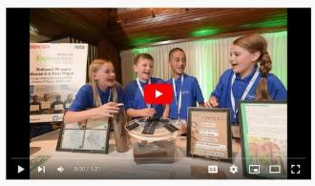
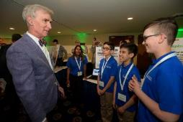
Past ExploraVision Winners, Grades 4-6
Technologies to remove microplastics contain in soil
Help reduce the frustrated hospital wait time with technology
“”Our team is mad with plastics. People could become sick from digesting too much plastic!.”
What one of the team members, Zach says about why they invented the ER Assistant.” – his video
Plastic is a problem because it is infesting our soil and showing up in our food. Fungi Plastivore Purifier (FPP) uses a compression system that inserts capsulated Pestalotiopsis microspora spores into the soil where plastics were located using advanced LIDAR technology. Pestalotiopsis microspora devours and breaks down polyurethane, turning it into organic matter. FPP will clean and purify our soil, leading to healthier food and water conditions while preventing serious illnesses.
The ER Assistant, is an ER reception with all the necessary tools and AI equipped to admit hospital patience and to diagnosed efficiently and effectively.

Slide 20
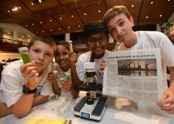
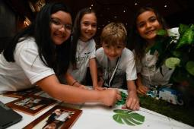
Past ExploraVision Winners, Grades 4-6
An effective roofing alternative
A New Way to Combat noise pollution
“We wanted to tackle a climate change and wanted to do naturally.” – Algatile team, Aditya Thakar (click & watch how they came up with the idea)
“Exposure to continual noise causes stress, poor concentration, hearing loss, and heart conditions. Recent research states that noise effects children’s learning.”
Algatiles consist of a polycarbonate sheet that algae grow under and a sheet of steel that algae grow on. Algatiles offer an effective roofing alternative that counters anthropogenic carbon dioxide in the atmosphere. The Algatile system supports the algae's basic needs: fresh water, sunlight, and CO2 to photosynthesize. Algatile will absorb thirty-two pounds of CO2 per year.
RMF (Relinquit Mutatio Figura) seeks to help societies across the globe combat noise pollution. Their project, “RMF: Leaves Changing Shapes uses liquid-elastomers (LCE’s) and 4-D printing, creating a leaf shape-shifting system to absorbs sound waves. RMF also returns natural environmental sounds into communities, ultimately absolving health risks associated with noise pollution.

Slide 21
Engineering Process for Problem Solving
The engineering process is often used by professional engineers to solve problems and it can be used to structure your team’s ExploraVision efforts:
Identify and define the problem
Gather information and perform research
Brainstorm and develop possible solutions
Design your solution
Build a prototype
Test it
(Rebuild it, if needed)
Evaluate your solution
Notes:
Teacher Note:
Watch this video to help students gain an understanding of the engineering process and why problem solving is important
Engineering Process
Solve Problems: Be an Engineer

Slide 22
Components Required to Complete a Project
Abstract
Description
Present Technology
History
Future Technology
Breakthroughs
Design Process
Consequences
Bibliography
Sample Web Pages
Note: please visit here for theK-3 and 4-6 entry template
Project Formats
Grades – K-3 Storyboard
Grades 4-6
Presentation (Slides/Google Slides or Standard ExploraVision Project Format)
Notes:
Teacher Note:
This page helps you to explain what “research paper” is
Touch on Breakthroughs, Design Process, and Consequences using the following page

Slide 23
Key Components: Breakthroughs, Design Process, and Consequences
Breakthroughs: Research and describe the breakthroughs necessary to make your future technology a reality. Describe why this technology doesn’t exist today. Choose one of your required breakthroughs and describe an investigation that would need to be carried out to test your project. If possible, include the kind of data or measurements that would be collected in this investigation.
Design Process: Describe three different features your team considered for the design of your technology. These features should be directly related to your current project, not one submitted in previous years. Describe why your team rejected each feature in favor of the ones in the submitted technology. Explain why the features in your submitted project are better than the ones you rejected.
Consequences: Recognizing that all technologies have consequences, describe the potential positive and negative impact of this new technology on society.
Notes:
Teacher Note:
Point the students in the direction of some emerging technologies that may be useful
Go over each section with your students to help them write their research paper

Slide 24
Summary and Sources: Abstract and Bibliography
Abstract:
An abstract should help the reader understand your project quickly and encourage them to read on
In no more than 150 words, summarize your proposed future technology and other relevant information
Bibliography:
Include all research sources in the bibliography. Please cite in MLA or APA
Sources must be clearly labeled and include title, author, publisher, and copyright date (depending on citation format)
Notes:
Teacher Note:
Explain students a concept of Abstract and Bibliography
Teachers should help students by going over to help them complete

Slide 25
Communication: Website & Video
Each team will learn how to best communicate the value of their project. Teams can either hand-draw or build actual websites that succinctly explain their project in 5 pages or fewer.
Images, text and diagrams need to include descriptions of future ideas/technologies
When possible, use data to backup your project’s claims
If your team wishes to create a video, consider using the website as a “storyboard” to layout the important themes
Not able to build a website? Consider these: Word (horizontal letter), PowerPoint or hand-drawn
Notes:
Teacher notes
Students will be put together their idea in 5 web pages. They would need to think about the best way to communicate the idea.
Students need to include images of future idea/technologies
It would enforce their case if they use statistics and charts

Slide 26
Judge Expectations
Who are our judges?
ExploraVision judges are career scientists, innovators, engineers and industry professionals who recognize the value of STEM education. Past judges worked for NASA, UPenn and other forward-thinking organizations.
Due to their deep expertise, judges can assess the feasibility of submitted projects.
Each judge awards points for ideas that haven’t been invented, overall creativity, scientific accuracy, strong communication, and feasibility of the project’s vision
Judges award higher scores to entries that are different from those that have previously won
Judging is divided into two phases: regional and national judging. All eligible projects will be evaluated in the regional judging phase
24 regional winning teams will move on to national judging, where 8 teams become finalists

Slide 27
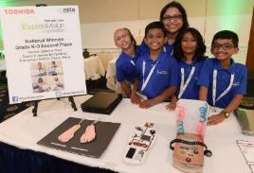
Resources
ExploraVision website (more details on the entire program)
Tap into Skype a Scientist, which connects established scientists and K-12 students via video chat for 30-60 minute, Q&A sessions
Ask for mentorship from parents or other adults in the community who work in field(s) related to the project
Collaborate with school librarians for research and language arts teachers for communicating the big idea
Useful websites for students: NASA Climate Change, Kids National Geographic, Robotics for Kids, Referral MD, What’s an Engineer?, EIA for Kids, DOE Sustainable Energy, USPTO for Kids
Useful websites for teachers: Robotics, Science Friday, NASA, ASCE, NGSS

Slide 28
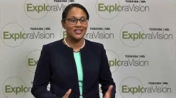
Resources
NSTA’s Science Competition Director on ExploraVision:
What is ExploraVision
How to Kick Off ExploraVision
How to choose an ExploraVision topic
How to Form ExploraVision Teams
How to Keep Your Team Motivated
How to Prepare for ExploraVision Project and Get Started
ExploraVision FAQ video

Slide 29
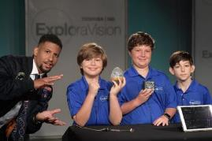
Resources
Past ExploraVision teachers have used this program as a tool to motivate students and bring schools together. Here are a few ideas to inspire you:
Teachers at a magnet school in Nashville organized a school-wide Shark Tank-style program where teams presented their projects before a panel of four, including a non-science teacher, a parent, a community representative, and an expert in STEM
A teacher in Atlanta hosted an award ceremony for upper grades with district leadership
In Ottawa, a teacher celebrated the end of the year-long program with cupcakes

Slide 30
Resources & Collaboration Tools
Getting your students organized and ready for this FREE K-12 STEM competition can be done easily and virtually through the use of online tools such below.
Are you overwhelmed in this school year? Have questions or want to know tips on how to introduce to your classroom and how to get started virtual teams?
Email to: exploravision@nsta.org

Slide 31
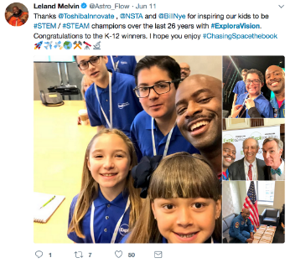
Social Media
Search #ExploraVision on Twitter, Facebook and Instagram to get how other educators are using ExploraVision and keep motivating students
You will see cool photos from the ExploraVision winners as well as teachers chronicling their teams’ projects over the school year.
Follow Toshiba on social media for program updates and inspiration!
Join our Community!
@ToshibaAmerica | ToshibaAmerica| @toshiba_STEMeducation

