Slide 1
Problem Solving and Critical Thinking Through Project-Based Learning
An all-in-one STEM guide for getting starting with ExploraVision
For educators teaching grades 7-12 in the U.S. and Canada

Slide 2
Table of Contents
What and Why is ExploraVision and how you can incorporate in your classroom?
Introducing the Toshiba/NSTA ExploraVision competition
Brainstorming: Solve Problems by Asking Questions
Brainstorming: Inventors Who Solved Problems
Brainstorming: Generating ExploraVision Ideas
Research: Understanding Your Topic
Research: Past ExploraVision Winners
Research: Engineering Process for Problem Solving
Research: Components Required to Complete a Project
Key Components: Consequences, Design Process, and Breakthroughs
Summary and Sources: Abstract and Bibliography
Communication: Website & Video
Judge Expectations
Project Resources

Slide 3
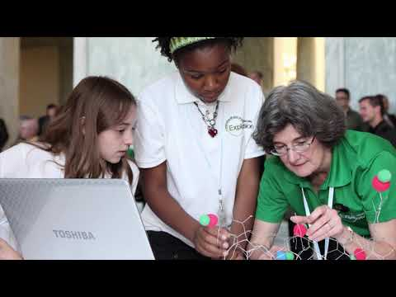
What is ExploraVision?
Through Toshiba’s shared mission and partnership with NSTA, the Toshiba/NSTA ExploraVision competition has made a vital contribution to the educational community for over 30 years. It is a FREE critical-thinking and collaborative program and all students receive recognition for participating in the competition.

Slide 4
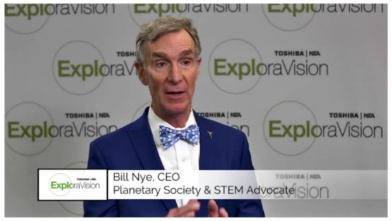
Why ExploraVision?
Why Bill Nye the Science Guy loves ExploraVision and his advice for students

Slide 5
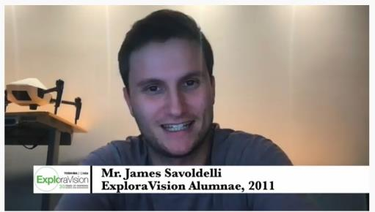
Why ExploraVision?
The impact ExploraVision made and the applicable skills the alumni have learned from ExploraVision.

Slide 6
How you can incorporate in your classroom?
How does she engage her high school students in ExploraVision? Learn from a multi-awards winning coach, Mrs. Cynthia Smyser, who uses our program to encourage her students to enrich them

Slide 7
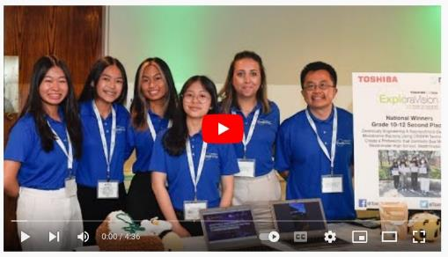
How you can incorporate in your classroom?
How do he engage his students in ExploraVision? Mr. Huy Pham who uses the program to encourage his students in the immigrant community to build critical-thinking, communication, and collaboration skills, and unleash their creativity.

Slide 8
How can you incorporate in your classroom?
How does Ms. Laura Laun, a 7-9 teacher. engages her students and keep winning in ExploraVision? Learn from the coach uses the program and her advise,

Slide 9
Introducing Toshiba/NSTA ExploraVision
ExploraVision is a STEM competition for K-12 students in the US and Canada
It challenges students to think creatively yet collaboratively about current scientific research and technology and its limitations
Teams of 2-4 research an existing technology and envision what that technology might look like 10 or more years in the future
Teams then identify what scientific “breakthroughs” are required for their idea to become a reality and describe the consequences that technology may have on society
Teams then write an online research paper and create sample web pages to describe their invention
Finalists then develop a prototype and build a website and online live presentation to the judges of their invention
ExploraVision is more than a science fair or a competition—it lets you dream big and solve a problem you care about using science!
Notes:
Teacher notes
Introduce the competition
Toshiba/NSTA ExploraVision engages students to showcase their innovative and creative problem-solving projects.
It also reinforces key skills that they already use everyday - creativity, communication, problem solving, critical thinking - and they can get rewarded for it with prizes (top prize: $10,000 savings bond, Chromebook, a trip to Washington, D.C., and a chance to meet Bill Nye the Science Guy!)
Open to all K-12 grades students in the U.S. and Canada, the competition has been running since 1992 and close to 450,000 students have participated. Students can explore some of the previous finalists on www.exploravision.org
It’s about finding a problem to solve, thinking about how you might solve it, and presenting your future solution.
Teachers play a coaching role and students form a group of up to four people- you could choose to group students at the start, or once they have thought of ideas.
Elaborate on “breakthroughs” and the “research paper.” You could use examples from the ExploraVision entry component page in this presentation

Slide 10
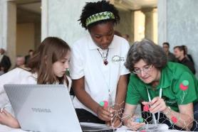
Brainstorming: Solve Problems by Asking Questions
How can we safely and easily bring light to people who need it?
How can we keep our clothing dry and stain-free?
How can we keep our soldiers safe from bullets?
How can we allow people to connect and find information easily?
Notes:
Teacher notes:
Ask students to answer these questions and think about inventors as they brainstorm problems that need solving
For older students, ask them to think about inefficiencies they experience in daily life. Phrase those as questions. For instance, “How can you improve the battery life of your phone without closing all of the apps?”

Slide 11
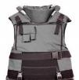
Brainstorming: Inventors Who Solved Problems
Early 1900’s: Ichisuke Fujioka developed an economical, durable, mass-market light bulb.
1956: Patsy Sherman invented Scotchgard, a water and stain repellent.
1965: Stephanie Kwolek invented Kevlar, a strong, synthetic fiber used in body armor.
2007: Steve Jobs developed Apple’s first widely-adopted smartphone.
Ichisuke Fujioka, Co-founder, Toshiba
Matsuda Lamp
Patsy Sherman, Chemist & Inventor, 3M
Scotchgard
Stephanie Kwolek, Chemist, DuPont
Kevlar
Steve Jobs, former CEO, Apple
iPhone Gen. 1
Notes:
Teacher notes
Explain that all these inventions solve a specific problem
Ask students to look around them and think ‘how could that be better?
Introduce the idea that inventions are often discussed in terms of impact - how much they have changed many people’s lives.
The first step in any invention is coming up with a problem that hasn’t been solved
It’s key that students are passionate about the problem

Slide 12
Brainstorming: Generating ExploraVision Ideas
Need help brainstorming? Encourage students to solve global challenges in the 17 areas addressed by the UN SDGs.
Past ExploraVision winners developed solutions to reduce food waste, eradicate disease, improve energy efficiency and more.
Learn more about UN SDGs

Slide 13
Brainstorming: Generating ExploraVision Ideas
Step One: Thought Starters
Does your family or community face any environmental or health issues?
Do any current technological devices or scientific solutions address these issues?
Are there any current events or problems that make you worried for your future? (Examples: pollution, climate change, disease, natural disasters)
What technology do people currently use and how could it be improved?
Think about which of these areas you are interested in investigating further.
Notes:
Teacher notes
Ask your students these questions and share their story
It might be a great way to collaborate with social study or English teacher
Ask students to bring some of the current stories on the newspaper or science websites and share with the class
Ask students to pick and write about a technology they use and want to improve- encourage them to be creative with their ideas as a homework
For higher grade teachers: ask students to go through some of the science-related websites to read up on some of the technology and/or issues they’re interested in and want to know more and improve

Slide 14
Brainstorming: Generating ExploraVision Ideas
Step Two: Generating Investigative Questions About Problem Area
What questions do you have about the problem area?
Refine your questions:
How can we…?
Is there an alternative to…?
How much does…?
Could we create…?
What if…?
Is it possible…?
Rank your questions in order of interest:
1.
2.
3.
Notes:
Teacher notes
Ask students to list all questions outlining what they would investigate.
Help your students to paraphrase their questions to “How can we...?” or “Is there an alternative to…?”
Students use the sentence starters above to help formulate their question.
Students rank questions to top 3 to investigate.

Slide 15
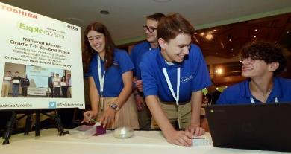
Brainstorming: Generating ExploraVision Ideas
Step Three: Categorizing Your Questions into Subject Areas
Do your investigative questions fall into any of these categories?
Climate change
Sustainable energy
Food shortage/population growth
Space
Healthcare
Mental health & social sciences
Robotics
Artificial Intelligence
Infrastructure/civil engineering (building bridges, etc.)
Can you expand or modify your questions based on these areas of concern?
Notes:
Teacher notes
Also introduce these areas of issues to students to help them expand their questions and area of concerns
Ask students to pick top three and share why they’re interested in the area of concerns
Might want to remind or introduce what AI is
https://www.youtube.com/watch?v=R1EH5GvydEE&vl=en-US
https://www.youtube.com/watch?v=mJeNghZXtMo

Slide 16
Research: Understanding Your Topic
How is your area of concern impacting local or global communities?
What improvements could be made in this area?
What inventions already exist in this area?
What recent improvements have there been in this area?
What key problems are there in this area?
What’s the history and future of the area?
Notes:
Teacher notes
Give homework depending on students’ area of concerns, provide further reading resources link to them; Science Friday, National Geographic, NASA, IBM, Referral MD, ASCE, Environmental Science, DOE Sustainable Energy, NASA Climate Change, Robotics, USTPO for Kids

Slide 17
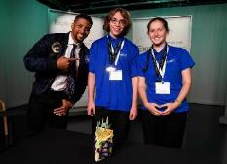
Past ExploraVision Winners, Grades 7-12
Using mycelium to create eco-friendly fabrics
Transporting perchlorate-reducing in mycelium to enable agriculture on Mars
“The textiles industry is known to be the second largest contributor to pollution.”
My partner is passionate about botany and I’m fascinated by Space science and Mars..”
Fungi Fabrics uses mycelium to create the fabric. The substrate should have a smooth texture so the fungi does not intertwine with the substrate. The substrate must have enough sugars for the fabric to grow evenly throughout the product. When the fabric needs to be disposed of it can be thrown in soils or water without a problem and break down toxic waste and bacteria which will clean our land and benefit the environment.
Agriculture on Mars is hindered by the presence of perchlorates in Martian regolith.. Perchlorate-reducing bacteria can effectively reduce perchlorates into chloride and oxygen. In order for such bacteria to be able to survive and transport itself through the arid Martian regolith, transporting Martian Mycrops, perchlorate reducing bacteria via fungal mycelium to Mars, we can efficiently reduce perchlorate concentration in Martian regolith and start safe agriculture on Mars.
Notes:
Teacher notes
Explain that all these inventions solve a specific problem
Ask students to look around them and think ‘how could that be better?
Discuss the idea that inventions are often discussed in terms of impact - how much they have changed many people’s lives.
The first step in coming up with a problem and haven’t been solved
It’s key that students are passionate about the problem

Slide 18
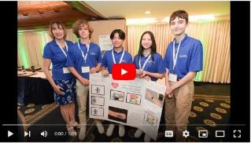
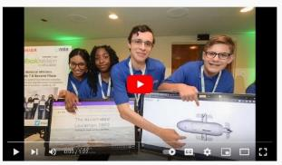
Past ExploraVision Winners, Grades 7-9
A New Way to Prevent Coronary Heart Disease with Nanobots
Addresses a microplastics issue in the ocean with a ROV
“Me and my team mate are passionate about saving human lives.“ -- Aura Sukapanpo-tharam
“We wanted to address microplastics issue in the ocean after having learned about it.“ -- Amber Gutu
The CC Bot is a nanobot that can detect and eliminate heart disease before it takes a life. It’s equipped with nano-biosensors, ultrasound, and artificial intelligence for early detection. To eliminate any problems within the arteries, it leverages macrophages to remove plaque. The nanorobot communicates using electromagnetic radio waves with a smart device such as a smartwatch which provides information through the display for the user.
The A.L. 3000 is an autonomous ROV that filters microplastics from the ocean. The drone cruises beneath the surface and uses echolocation technology to detect microplastics, which are then passed through a fine filter to separate them from the seawater. The filter is subsequently exposed to plastic-digesting bacteria that degrade the collected microplastics.
Notes:
Teacher notes
Explain that all these inventions solve a specific problem
Ask students to look around them and think ‘how could that be better?
Discuss the idea that inventions are often discussed in terms of impact - how much they have changed many people’s lives.
The first step in coming up with a problem and haven’t been solved
It’s key that students are passionate about the problem

Slide 19
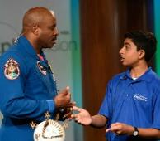
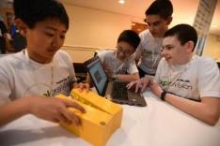
Past ExploraVision Winners, Grades 7-9
A one-use cure for Hepatitis B Virus (HBV)
Reducing road maintenance and preventing accidents significantly
This project is a novel one-use cure for HBV that contains a CRISPR-Cas9 cocktail specific to the genes for HBx (an important protein coded by the HBV genome) and NTCP (the receptor used by HBV to enter a patient’s liver cell) using lipid nanoparticles targeted to the liver. Inhibiting HBx and NTCP with CRISPR-Cas9 will eliminate the virus from infected liver cells and cure patients with a single delivery.
“According to the U.S. Department of Transportation, each motorist spends $290 on average on car repairs due to deteriorating roads each year, totaling $410 billion per year. “
“It wasn’t as fun as it was if I didn’t work with my team mate.” - Akshar Ramkumar (click & watch how they came up with the idea, how they worked and what he learned.)
Damaged road surfaces cause popped tires, broken axles, and loss of vehicle control, which lead to accidents. To address the continuous issues motorists experience as a result of damaged road systems, the team envisioned, “NewFerro Roads,” which revolutionize road maintenance by using an advanced magnetic nanofluid, Phase-Mag Fluid (PMF), which allows the road to self-repair.
Notes:
Teacher notes
Explain that all these inventions solve a specific problem
Ask students to look around them and think ‘how could that be better?
Discuss the idea that inventions are often discussed in terms of impact - how much they have changed many people’s lives.
The first step in coming up with a problem and haven’t been solved
It’s key that students are passionate about the problem

Slide 20
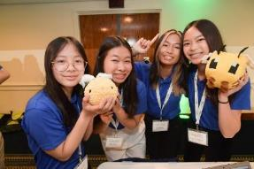
Past ExploraVision Winners, Grades 10-12
The Smart Way to Detect Strokes
A Solution to Combat Bee Mortality from Insecticides
“”We have family member effected by a stroke, so we want to find a way to prevent it.”
iSpyStroke is a sleeping mask designed to target wake-up strokes, a type of stroke that occurs while a person is sleeping. Consisting of electroencephalogram sensors that can detect any irregular brain wave activity, it can alert medical professionals and emergency contacts through the connected app if a wake-up stroke is detected. Vibrators and alarms attached to the device will also awake the wearer.
Western honeybees are vital pollinators in promoting biodiversity and securing crop production. However, since the early 1990s, a group of insecticides have contributed to the decline of honeybees due to its toxicity that disrupts bee’s nervous systems. Our solution to combat bee mortality is a probiotic composed of neonicotinoid-degrading microbiome bacteria. Genetic engineering, CRISPR technology DNA cloning, and freeze-drying techniques will be utilized to develop a novel probiotic solution.

Slide 21
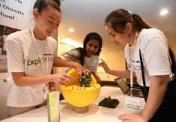
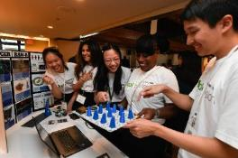
Past ExploraVision Winners, Grades 10-12
Genetically modify bacteria to tackle climate change
Help restore nerve and tissue function after chemoradiation
“I always wanted to go in bio or medicine, but this solidified for me.” -- Valeria Millan (click & watch how they came up with the idea and what impact it made on her.)
“My mom went through a chemoradiation and it was very difficult to see her go through the treatments, so I wanted to research an idea to ease her pain.”
This team engineered “M. Luteus” to fix the greenhouse gases methane and carbon dioxide. This method to reduce the amount of these gases in the atmosphere by genetically modifying the bacteria Micrococcus luteus strain ATCC 4698 is achieved by inserting carboxysomes and soluble methane monooxygenase (sMMO) operons into its genes.
This team designed the Cancer BAN-R: Blood and Nerve Regeneration. This device is a novel graphene patch which incorporates laser sensors, microneedles, nanotechnology, and growth hormones to provide noninvasive transdermal delivery of specialized therapeutics, helping to restore nerve and tissue function after chemoradiation.

Slide 22
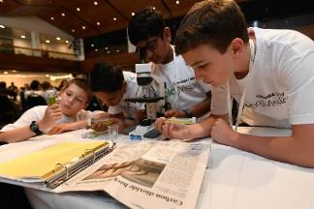
Engineering Process for Problem Solving
The engineering process is often used by professional engineers to solve problems and it can be used to structure your team’s ExploraVision efforts:
Identify the problem
Describe the problem in a “design brief,” including the constraints and limitations
Gather information
Brainstorm for solutions
Select a solution
Develop an implementation strategy
Design a prototype
Test
(Rebuild it, if necessary)
Complete the project
Notes:
Teacher Note:
Watch this video to help students to understand the engineering process and why we need to solve problems
Engineering Process
Explain your students there are various other process steps

Slide 23
Components Required to Complete a Project
Abstract
Description
Present Technology
History
Future Technology
Breakthroughs
Design Process
Consequences
Bibliography
Sample Web Pages
Research Paper (Standard ExploraVision Program Format - see left)
Notes:
Teacher Note:
This page helps you to explain what “research paper” is
Touch on Breakthroughs, Design Process, and Consequences using the following page

Slide 24
Key Components: Breakthroughs, Design Process, and Consequences
Breakthroughs: Research and describe the breakthroughs necessary to make your future technology a reality. Describe why this technology doesn’t exist today. Choose one of your required breakthroughs and describe an investigation that would need to be carried out to test your project. If possible, include the kind of data or measurements that would be collected in this investigation.
Design Process: Describe three different features your team considered for the design of your technology. These features should be directly related to your current project, not one submitted in previous years. Describe why your team rejected each feature in favor of the ones in the submitted technology. Explain why the features in your submitted project are better than the ones you rejected.
Consequences: Recognizing that all technologies have consequences, describe the potential positive and negative impact of this new technology on society
Notes:
Teacher Note:
Point the students in the direction of some emerging technologies that may be useful
Go over each section with your students to help them write their research paper

Slide 25
Summary and Sources: Abstract and Bibliography
Abstract:
An abstract should help the reader understand your project quickly and encourage them to read on
In no more than 150 words, summarize your proposed future technology and other relevant information
Bibliography:
Include all research sources in the bibliography. Please cite in MLA or APA
Sources must be clearly labeled and include title, author, publisher, and copyright date (depending on citation format)
Notes:
Teacher Note:
Explain students a concept of Abstract and Bibliography
Teachers should help students by going over to help them complete

Slide 26
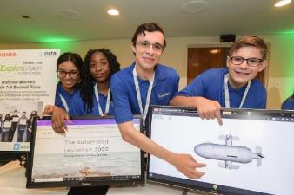
Communication: Website & Online Live Presentation
Each team will learn how to best communicate the value of their project. Teams can either hand-draw or build actual websites that succinctly explain their project in 5 pages or fewer.
Images, text and diagrams need to include descriptions of future ideas/technologies
When possible, use data to backup your project’s claims
For regional winners, your team wishes to practice a online live presentation to the judges, create a video, consider using the website as a “storyboard” to layout the important themes
Want to engage your students building a website? Consider these: Wix.com, Squarespace, weebly. Web.com, hibu
Notes:
Teacher notes
Students will be put together their idea in 5 web pages. They would need to think about the best way to communicate the idea.
Students need to include images of future idea/technologies
It’d enforce their case if they use statistics and charts

Slide 27
Judge Expectations
Who are our judges?
ExploraVision judges are career scientists, innovators, engineers and industry professionals who recognize the value of STEM education. Past judges worked for NASA, UPenn and other forward-thinking organizations.
Due to their deep expertise, judges can assess the feasibility of submitted projects.
Each judge awards points for ideas that haven’t been invented, overall creativity, scientific accuracy, strong communication, and feasibility of the project’s vision
Judges award higher scores to entries that are different from those that have previously won
Judging is divided into two phases: regional and national judging. All eligible projects will be evaluated in the regional judging phase
24 regional winning teams will move on to national judging, where 8 teams become finalists

Slide 28
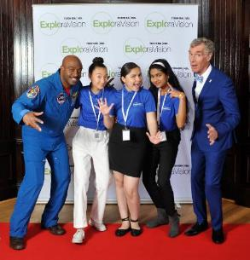
Resources
ExploraVision website (more details on the entire program)
Tap into Skype a Scientist, which connects established scientists and K-12 students via video chat for 30-60 minute, Q&A sessions
Collaborate with school librarians for research and language arts teachers for communicating the big idea
Ask for mentorship from parents or other adults in the community who work in field(s) related to the project
Useful websites for students: NASA Climate Change, Kids National Geographic, Robotics for Kids, Referral MD, What’s an Engineer?, EIA for Kids, DOE Sustainable Energy, USPTO for Kids
Useful websites for teachers: Robotics, Science Friday, NASA, ASCE, NGSS

Slide 29
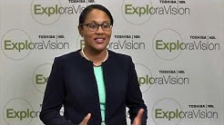
Resources
NSTA’s Science Competition Director on ExploraVision:
What is ExploraVision
How to Kick Off ExploraVision
How to choose an ExploraVision topic
How to Form ExploraVision Teams
How to Keep Your Team Motivated
How to Prepare for ExploraVision Project and Get Started
ExploraVision FAQ video

Slide 30
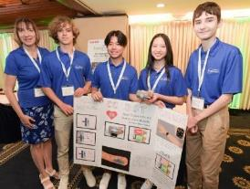
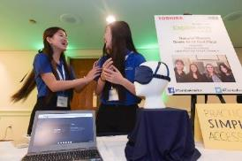
Resources
Past ExploraVision teachers have used this program as a tool to motivate students and bring schools together. Here are a few ideas to inspire you:
Teachers at a magnet school in Nashville organized a school-wide Shark Tank-style program where teams presented their projects before a panel of four, including a non-science teacher, a parent, a community representative, and an expert in STEM
A teacher in Atlanta hosted an award ceremony for upper grades with district leadership
In Ottawa, a teacher celebrated the end of the year-long program with cupcakes

Slide 31
Resources & Collaboration Tools
Getting your students organized and ready for this FREE K-12 STEM competition can be done easily and virtually through the use of online tools such below.
Are you overwhelmed in this school year? Have questions or want to know tips on how to introduce to your classroom and how to get started virtual teams?
Email to: exploravision@nsta.org

Slide 32
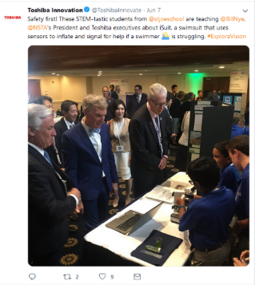
Resources & Social Media
Search #ExploraVision on Twitter, Facebook and Instagram to get insight of the program, how other teachers are using and motivating students
You will see cool photos and videos from our ExploraVision team as well as teachers chronicling their teams’ projects over the school year.
Follow Toshiba on social media for program updates and inspiration!
Join out community!
@ToshibaAmerica | ToshibaAmerica | @toshiba_STEMeducation

