Slide 1
Toshiba/NSTA ExploraVision
Introducing STEM Competition in Your Classroom
-- Program Guide --

Slide 2
About Toshiba/NSTA ExploraVision
ExploraVision is a STEM competition for K-12 students.
It encourages students to combine their imagination with their knowledge of science and technology to explore visions for the future.
Teams of 2-4 students select a technology, research how it works, learn why it was invented, and then predict how that technology may change in the future.
Students identify what “breakthroughs” are required for their idea to become a reality and describe the positive and negative consequences of their technology on society.
The students write a paper and draw a series of web pages to describe and communicate their idea.
Finalists make a visual poster (for K-3 grades) and an actual website (for 4-12 grades)* and a prototype of their future vision.
ExploraVision is more than a science fair or a competition—it can be a virtual or in-person tool to ignite every student’s enthusiasm for STEM subjects!

Slide 3
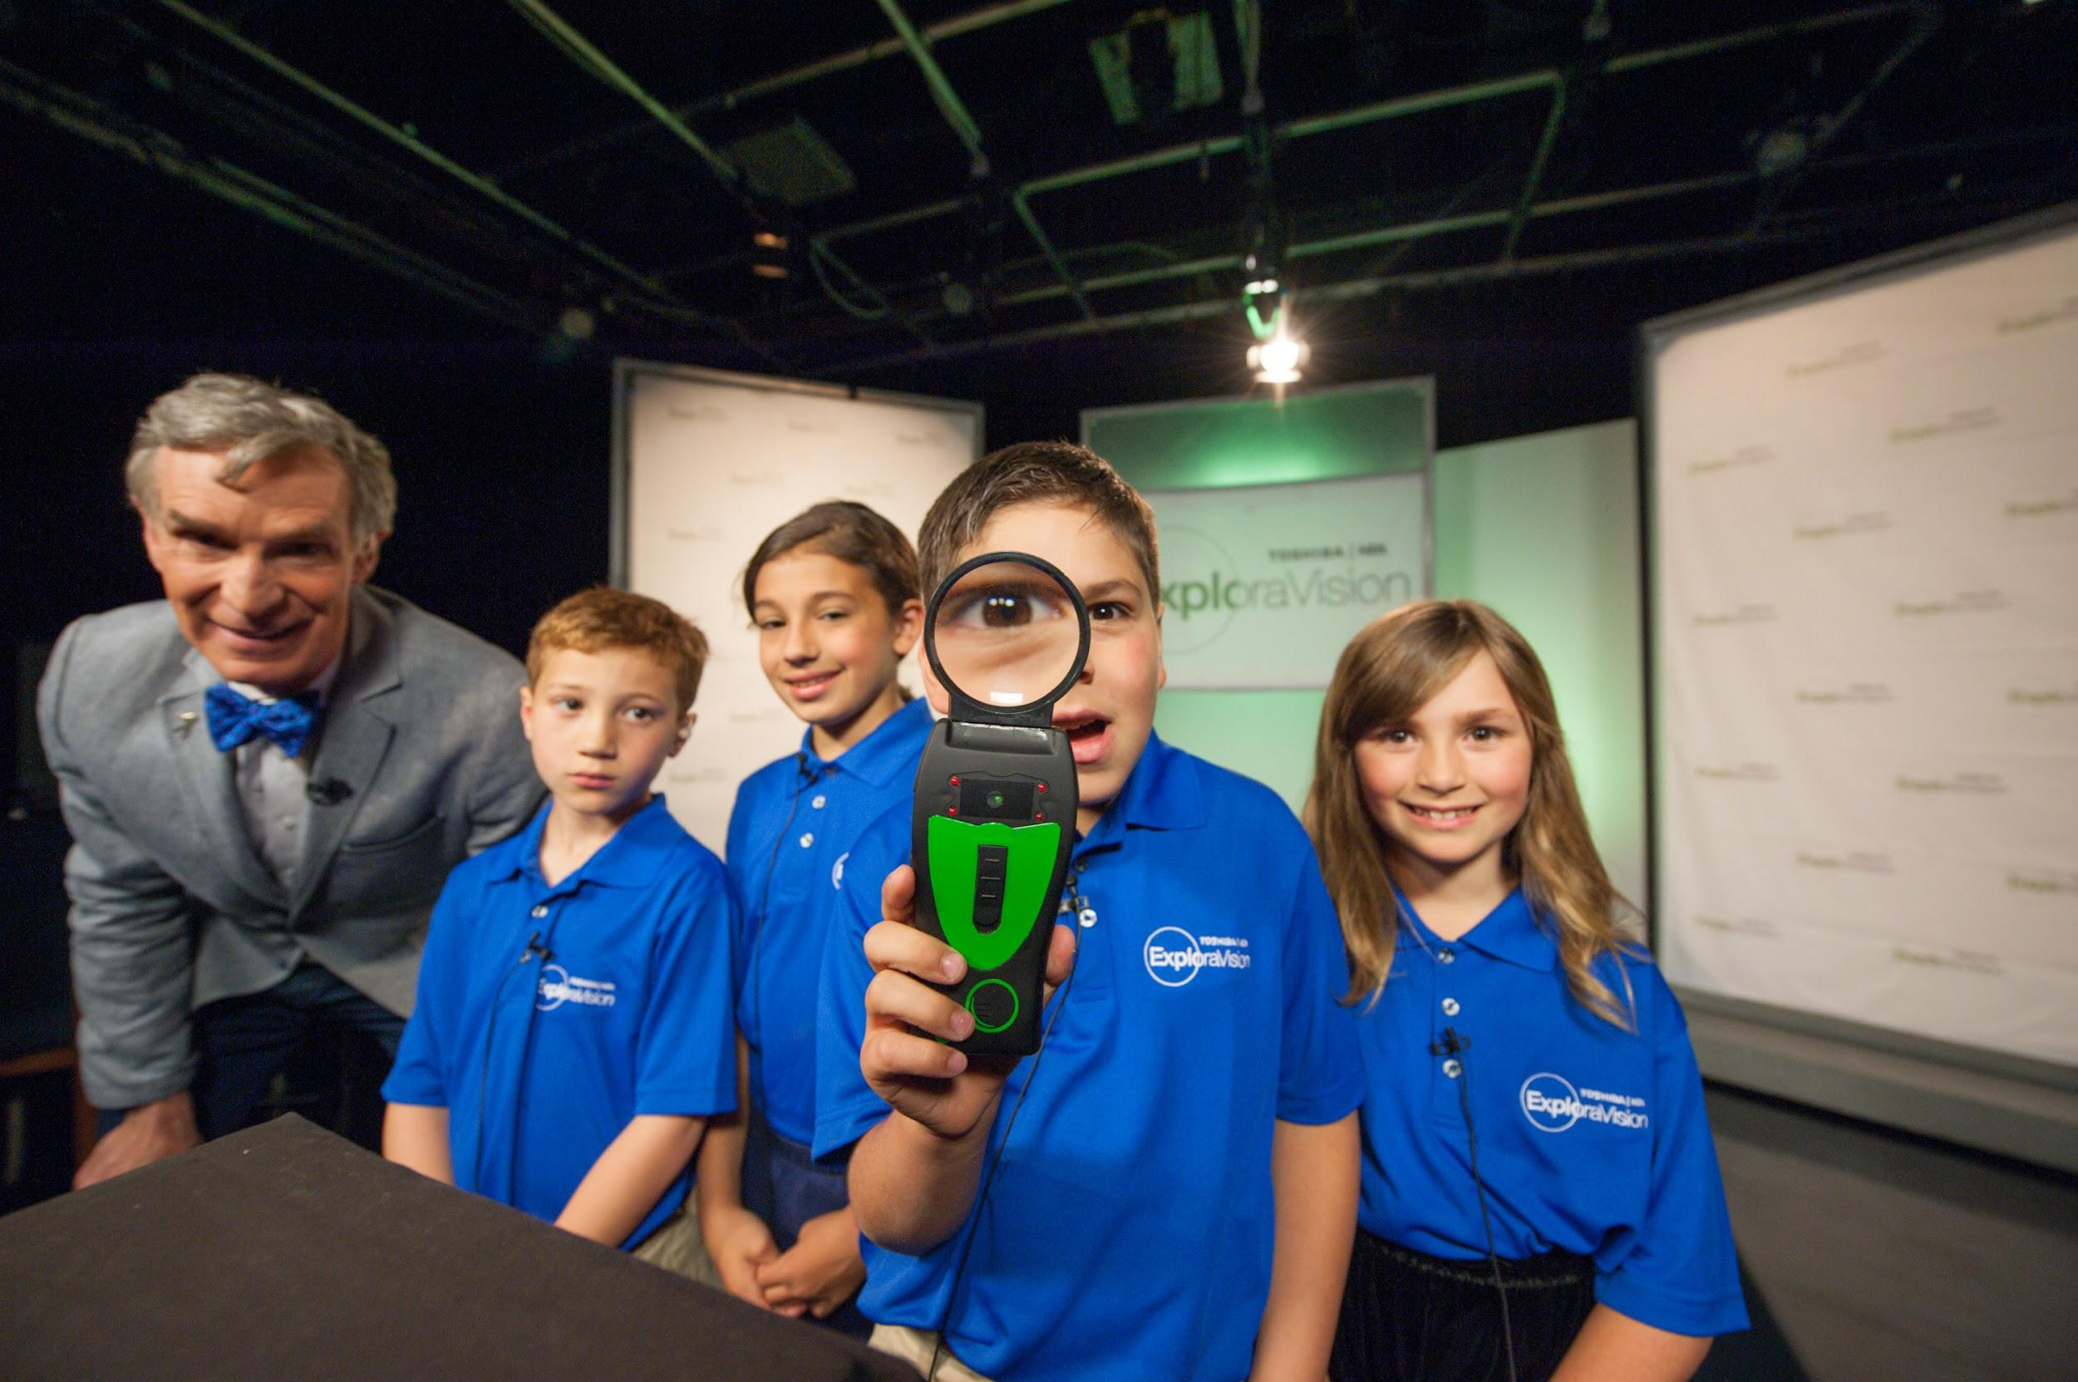
Video About Toshiba/NSTA ExploraVision
Watch About ExploraVision video
What Bill Nye the Science Guy has to say about the program (click here)
K-3 national winner, The Tick Detective team from NY (Picture left)

Slide 4
Why Participate in ExploraVision?
Engage students in project-based learning to solve real world problems
Help students, teachers, and the community become interested in STEM
Help students develop skills such as critical thinking and communication
Teach students how to work effectively in groups on an interdisciplinary project
Help steer students toward a lifetime of learning and curiosity
Teach multiple subjects in one project: STEAM, English, research & history
FREE to enter and everyone who enters receives a gift and a certificate from ExploraVision!

Slide 5
Prizes -- For The Students
$10,000* savings bond for each first-place team member and $5,000* for each second-place team member
An trip to Washington, D.C. in June for ExploraVision Awards Weekend for each national winning student and their parents/guardians
A Chromebook for each regional winning student
A unique prize for all students on the 500 Honorable Mention winning teams
A certificate of participation and an entry gift for every student who submits a complete project
* Savings bonds maturity value

Slide 6
Prizes -- For The Schools
A technology/science-related gift for each of the schools of the regional winning teams
National press coverage and national recognition
An awards ceremony for each regional winning team at their school where they will receive a winner’s banner, plaque, and other gifts

Slide 7
Prizes -- For Teachers/Coaches and Mentors
A trip to Washington, D.C. in June for ExploraVision Awards Weekend for the teacher/coach or mentor of each national winning team
A one-year NSTA membership for teachers/coaches of the national winning teams
A certificate of participation and an entry gift for each coach and mentor of every team that submits a complete project
A Chromebook for the teacher/coach of each regional winning team
A trip to an NSTA conference for ExploraVision Ambassadors

Slide 8
ExploraVision Key Dates
Coach registration Open: July 18, 2022 at www.exploravision.org
Project Entry Due: January 31, 2023 at www.exploravision.org
Regional Winner Announcement: March 20, 2023
National Winner Announcement: May 5, 2023
Awards Weekend: June 7 - June 9, 2023 in Washington, D.C.

Slide 9
General Requirements -- Students
Must be full-time K-12 students
Must be currently enrolled in and attending a public, private, or homeschool in the U.S. or Canada
Must not be older than 21

Slide 10
General Requirements -- Teachers/Coaches/Mentors
Teachers/Coaches:
Are required for each team
Must teach at a school attended by at least one of the team members
Cannot be a parent/guardian of a team member
May enter an unlimited number of teams
Should guide the students but not perform work on the project
Mentors:
Are optional
Can be an individual that represents an organization or business or be a parent/guardian of a team member
Should serve as a resource for the team but not perform work on the project

Slide 11
Project Entry Process
Step 1: Teacher/Coach registration at www.exploravision.org
Step 2: Register your team
Step 3: Teams begin working on their projects (e.g. brainstorm topics, research, etc.)
Step 4: Upload and enter projects
Notes:
Team project are entered online
A teacher may register as many teams as he/she wishes
Each team is automatically assigned a project ID number upon registration
Project must be submitted online or received at NSTA by 11:59 pm EST on January 31, 2023 to be considered

Slide 12
Project Format
Grades K-3 Requirements: K-3 grades team have a new project template to enter project.
- Video explanation of project components (Video)
- Grades K-3 Project Template (Template)
Grades 4-6 Requirements: 4-6 grades teams have a choice to submit projects in two types of format. Options include the standard ExploraVision project format* or a flexible presentation format. More details are on the video explaining project submission format options (Video).
Option 1:
- Grades 4-6 Presentation (PowerPoint Slide Style) Format Template (Template)
- Grades 4-6 Presentation (PowerPoint Slide Style) Format Sample Entry (Sample Projects)
Option 2:
- Grades 4-6 Standard ExploraVision Project Format. Sample Projects
Grades 7-9 Requirements
- Video Explanation of project submission requirements (Video)
- Grades 7-9 Standard ExploraVision Project Format Sample Projects
Grades 10-12 Requirements
- Video Explanation of project submission requirements (Video)
- Grades 10-12 Standard ExploraVision Project Format Sample Projects

Slide 13
Required Standard ExploraVision Project Format Components
Abstract -- 10 points
Description -- 10 points
Present Technology -- 10 points
History -- 10 points
Future Technology -- 20 points
Breakthroughs -- 15 points
Design Process -- 10 points
Consequences -- 10 points
Bibliography -- 5 points
Sample Web Pages -- 20 points * No student, coach, mentor, and school names should appear * Above sections should be clearly labeled and presented in exact order

Slide 14
Abstract
Abstract of no more than 150 words that summarizes the proposed future technology and other relevant information must precede other project components
Abstract should be on a separate page and does not count as part of the Description.
Project title is encouraged
No name of school/student/teacher should be stated as it’s a blind judging
It should be typed, double-spaced and clearly labeled
No minimum word count

Slide 15
II. Description
Each team must prepare a written description of the project that does not exceed 11 pages and can be a combination of text and artwork.
Must include the following sections-with headings clearly labeled- in the following order:
Present Technology*
History
Future Technology
Breakthroughs*
Design Process*
Consequences*
* Section is central to Next Generation Science Standards

Slide 16
II. Description -- 1/4
Present Technology
Give overview of chosen technology’s current form, including scientific principles involved in its functioning.
Define a problem or limitation of this current technology that you will address in your ExploraVision project.
B. History
Research and describe the history of the technology from its inception.

Slide 17
II. Description -- 2/4
C. Future Technology
Describe the team’s vision for what this technology will be in the future, including scientific principles involved in developing the technology.
D. Breakthroughs
Research and describe breakthroughs that are necessary to make the future technology design a reality.
Describe why this future technology doesn’t exist today.
Choose one of your required breakthroughs and describe an investigation that would have to be planned and carried out to test your ExploraVision project. If possible, include the kind of data or measurements that would be collected in the investigation.

Slide 18
II. Description -- 3/4
E. Design Process
Describe three alternative ideas of features the team considered for their project. The ideas and features should be directly related to the project, not a list related to other projects submitted in previous years or by other participants.
Describe why the team rejected each feature and idea in favor of the ones in the submitted technology.
Describe how your future technology feature is better than the rejected design feature.

Slide 19
II. Description -- 4/4
F. Consequences
Recognizing that all technologies have positive and negative consequences, describe the potential positive and negative consequences of the new technology on society

Slide 20
III. Bibliography
All sources used in researching the chosen technology should be referenced in the Bibliography.
Sources must be clearly labeled and include title, author, publisher, and copyright date.
Not counted as part of the 11-page limit for the Description.
Footnotes are encouraged, but not required.
No page limit for the Bibliography section.

Slide 21
IV. Sample Web Pages
Team members must prepare exactly five sample web pages that communicate and promote their future technology vision.
Must include description and illustration of the chosen technology.
One of the five pages should be a model or visual representation of the technology that could be used to create a prototype for display.
The model should help others visualize the design and should communicate the design features.
Web pages can be hand-drawn, on an actual website, or computer generated with text, pictures, photographs and diagrams.

Slide 22
Regional Judging
The judging committees are made up of leading science educators and science and technology experts
Judging is divided into two phases: regional and national judging
All eligible projects will be evaluated in the regional judging phase
24 regional winning teams will move on to national judging
The judging criteria for assigning points are based on creativity, scientific accuracy, communication, and feasibility of the project’s vision
Judges award higher scores to entries that are unique and different from those that have won previously

Slide 23
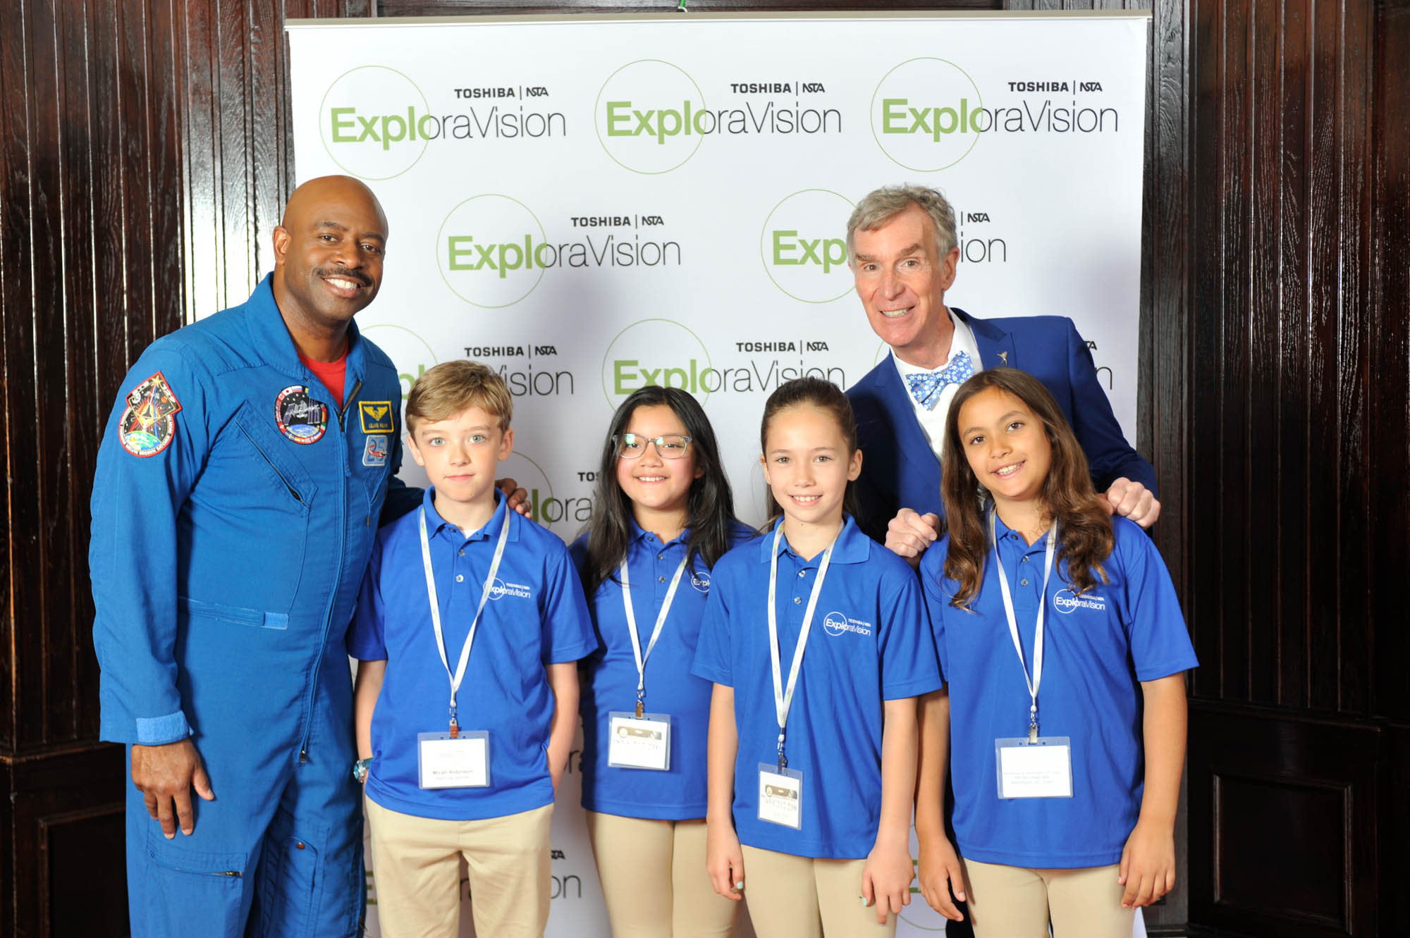
Resources
Register you and your students team
Sample Projects
Sample Project Timeline
Lesson Plan
FAQ
For more information
Email
Facebook
Twitter
Call: 1-800-explor-9
Through Toshiba’s shared mission partnership with NSTA, the Toshiba/NSTA ExploraVision competition makes a vital contribution to the educational community

